Slide 1
Attendance For Students
Graduation Project
Supervisor :
Dr. Bahaa Shabana
Our Team :
Ahmed Shaban
Alaa Talaat
Nourhan Elfaioumy

Slide 2
Table of Contents
1
2
3
Abstract
Problem Definition
Objectives
6
5
4
Implementations
Technologies and programming language
Project Analysis and Design

Slide 3

1
Abstract

Slide 4
Abstract
In most educational institutions, participation of students in learning process is regarded as a vital exercise for allowing knowledge transfer. This signifies the importance of having students to attend the scheduled lectures and classes. Conventional methods for recording student’s attendance are still adopted by most colleges. One common method is by having students to manually sign the attendance sheet, which is typically passed around the classroom while a lecturer is giving the lecture. This approach could undoubtedly allow the students to cheat about their attendance, where a student may sign for an absent student. Besides, such attendance sheet could easily be misplaced or lost.

Slide 5

2
Problem Definition

Slide 6

1- Difficulty recording absentee of paper.
2- Waste both time and efforts.
3- Difficult to extract reports.
4- Less security.
5-Losing the paper.
6- Registration error.

Slide 7

3
Objectives

Slide 8
Easy for recording absentee electronic.
The absence is recorded at the same time.
Save of both time and efforts.
Easy to extract reports.
More security.
Quicker and more accurate.
Installation is fast and simple.
Use open source software to minimize development and costs.

Slide 9

4
Project Analysis and Design

Slide 10

Project Management Framework
A project management framework consists of the processes, tasks, and tools used to take a project from start to finish. It encompasses all the key components required for planning, managing, and governing projects.

Slide 11
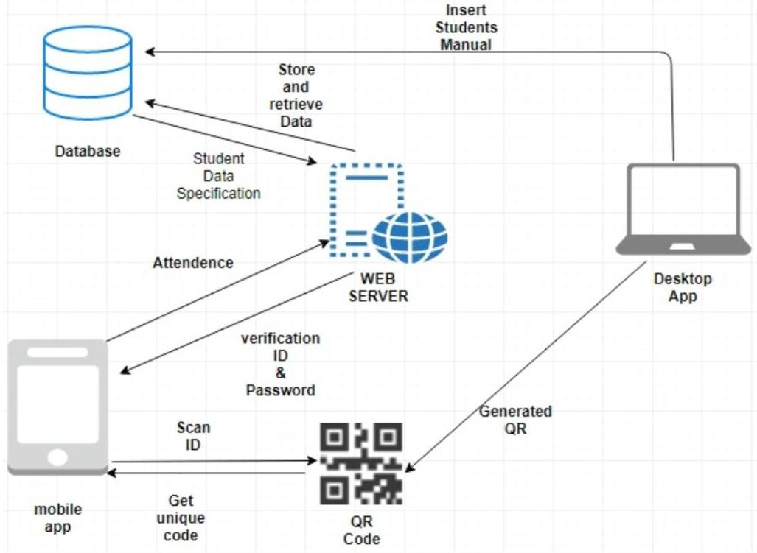
Attendance For Student Project Framework

Slide 12

4
Technologies and programming language

Slide 13









We provide some programming languages and some tools used in the implementation of the project.

Slide 14

5
Implementation

Slide 15


Implementation
A web application that generates QR code and it is linked to
a mobile application with API .
Web Application
Mobile Application
API

Slide 16
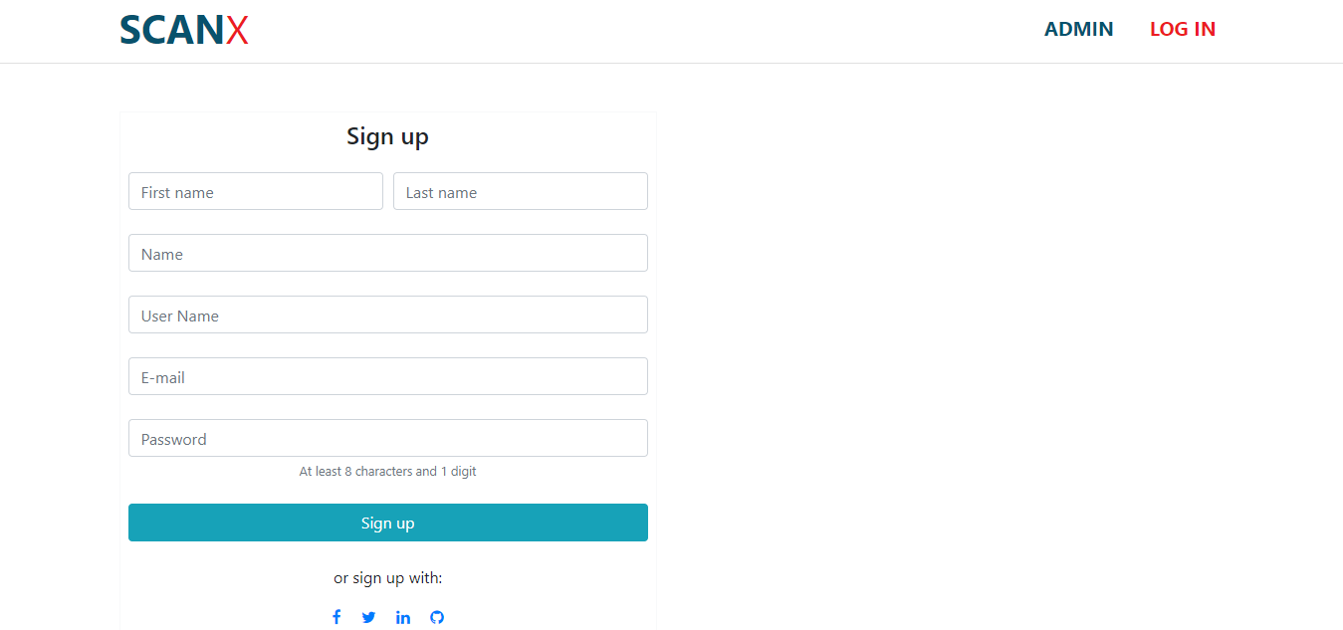
Implementation | Web App. Sign-up Page
First the doctor create an account for him to login to the system .
He enter his first and last name , user name , e-mail and password and click on sign up .

Slide 17
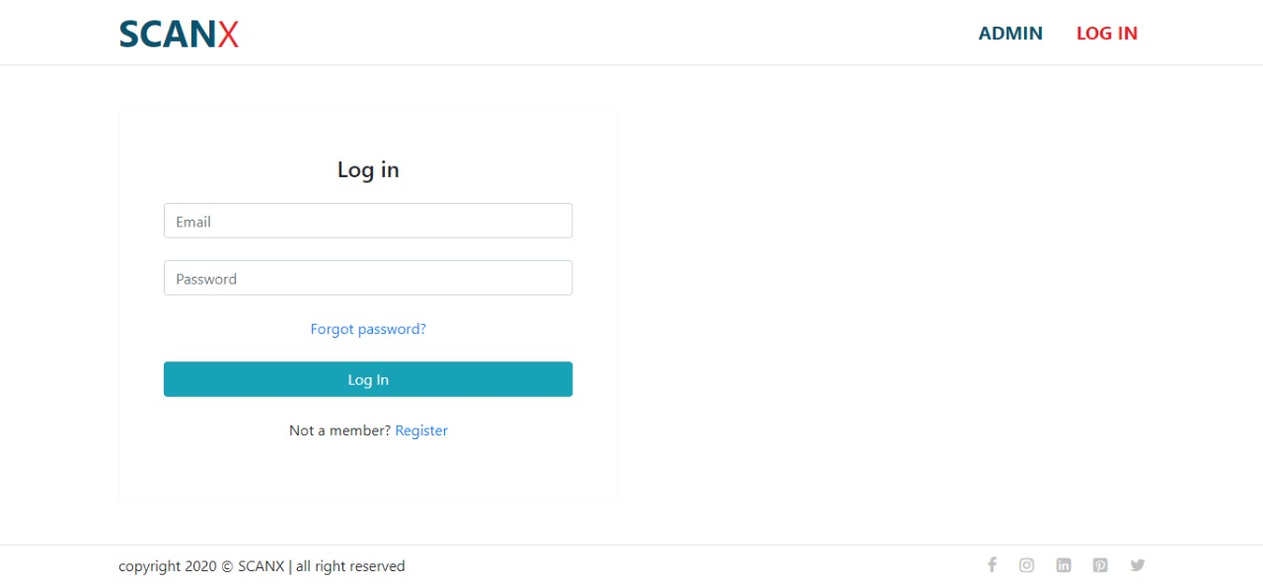
Implementation | Web App. Login Page
The doctor login with his e-mail and password to go to the home page .

Slide 18
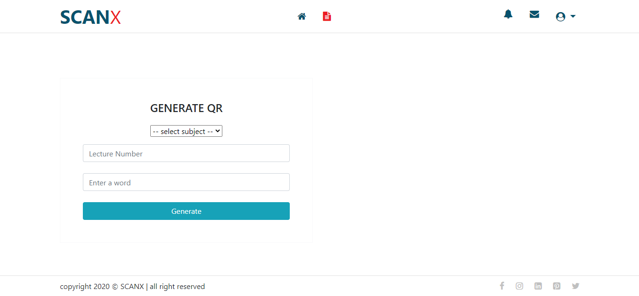
Implementation | Web App. Home Page
The doctor select the subject and lecture number then he enters a different word in every time he login to take the attendance of the student and click on generate to generate the QR code .

Slide 19
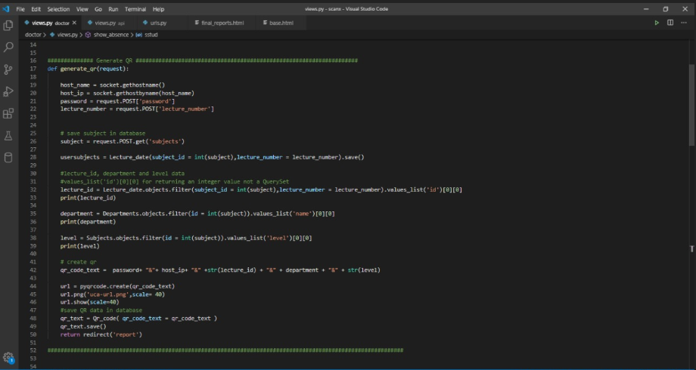
Implementation | Web App. QR code

Slide 20
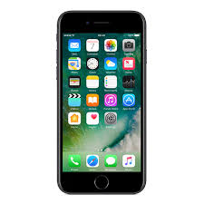

Implementation | Mobile App. Splash screen
This page is existed before login page or home page if the student login before .

Slide 21
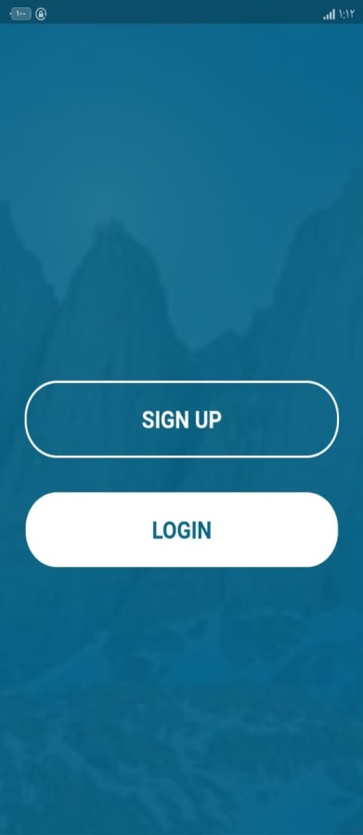
Implementation | Mobile App. First screen
There are two buttons :
-Signup button
-Login button

Slide 22
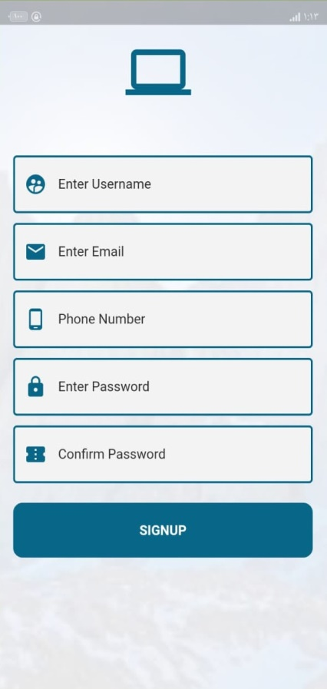
Implementation | Mobile App. Sign-up screen
On this screen student insert his name , e-mail , phone number and password to create an account for him on the app to login .

Slide 23
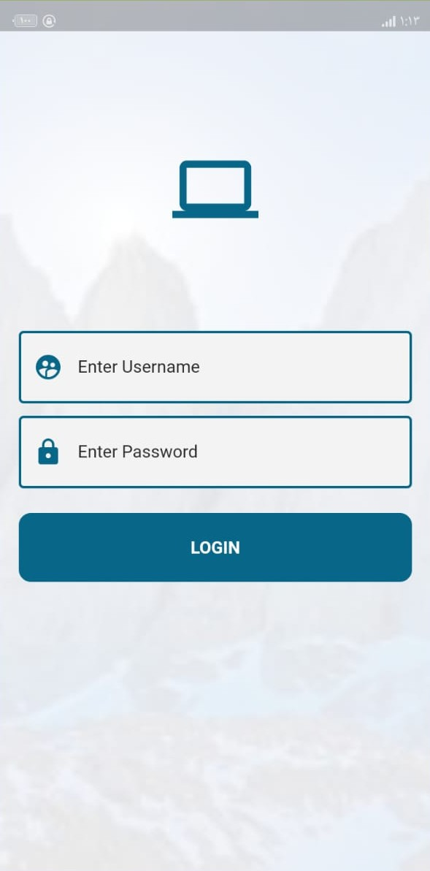
Implementation | Mobile App. Login screen
On this screen, Students can log in by their names and password which is token by data base administrator .

Slide 24
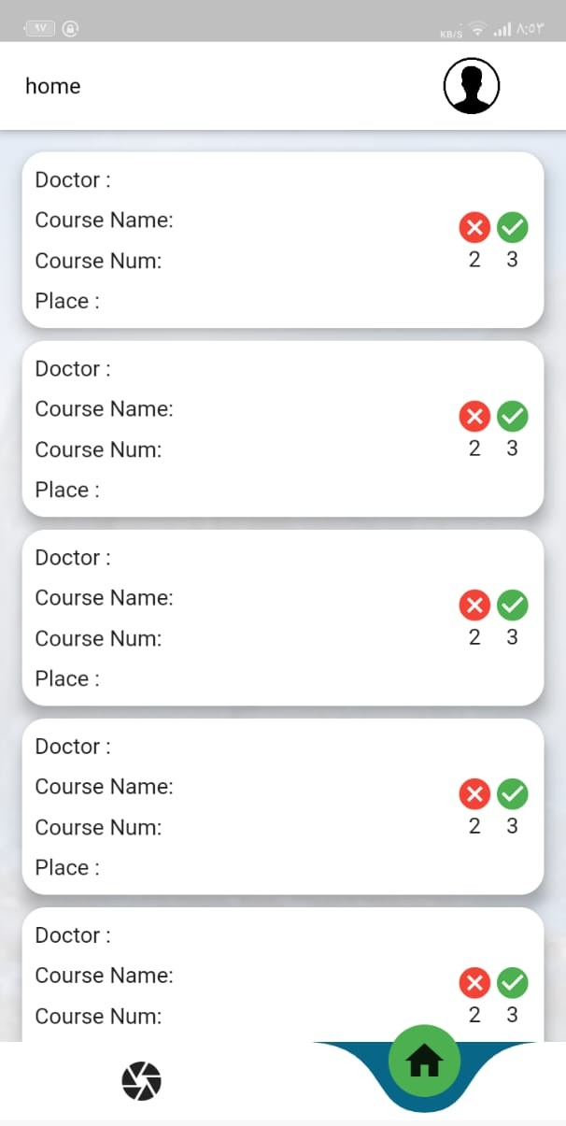
Implementation | Mobile App. Home screen
Here student can see the doctor name , course name , place and how many times he attended .

Slide 25
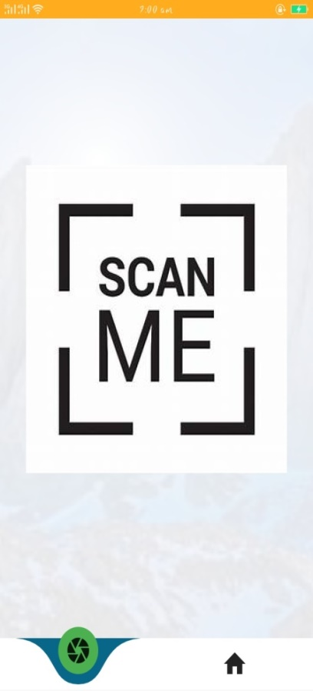
Implementation | Mobile App. Scanning screen
When students capture QR code then the system scan it and compare it with the QR code exist in data base then they are the same it is successful.

